Slide 1
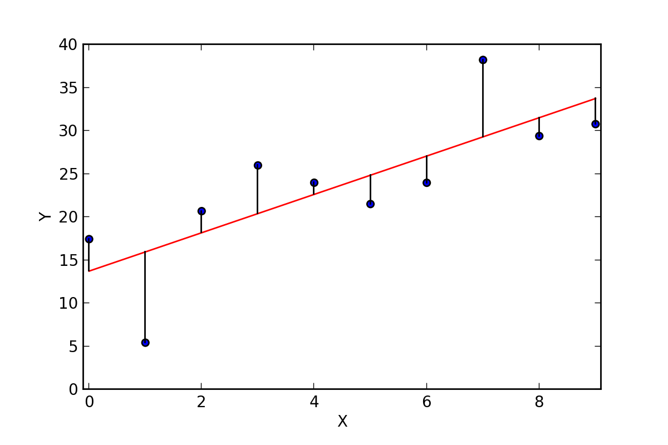
Linear Regression (Y = wX + b)

Slide 2

X is feature space i.e. x1,x2,x3,x4,x5.............
Y is target variable which is continuous i.e. numeric
Weight of the equation is w which is a vector i.e. w1,w2,w3......
Bias is coined as b
Random weights and bias is initialized and a loss is calculated i.e. MSE (mean squared error) in this case
An optimizer is used e.g. gradient decent to make adjustments to weights and bias, with objective of minimization of loss
A model is trained on n epochs and R2 is observed to measure goodness of fit

